Slide 1
Python Programming
Session 1: (Data Structures and Control Flow)

Slide 2
Agenda:
1 | Data Containers
2 | Control Flow

Slide 3
Data Containers

Slide 4

Data Containers
Python provides several built-in data structures (or containers) to organize and manage data efficiently. These include lists, tuples, sets, and dictionaries.
Lists
A list is an ordered, mutable collection of items. Lists can contain items of different types, including other lists.
Syntax
Lists are defined using square brackets [ ]
Key Characteristics of list
Ordered: Lists allow access to items using an index.
Mutable: You can add, delete, or modify items in a list.
Non-Unique Items: Lists can contain duplicate elements.
Mixed Data Types: Lists can hold items of different data types.

Slide 5


Data Containers
Lists Operations
Indexing
Access elements using their index (starting at 0)
Slicing
Access a range of elements

Slide 6

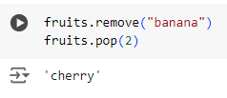
Data Containers
Lists Operations
Adding Elements
Use append() to add an item, insert() to add at a specific index.
Removing Elements
Use remove() to delete an item, pop() to remove by index.

Slide 7


Tuples
A tuple is an ordered, immutable collection of items. Once defined, its contents cannot be changed.
Syntax
Tuples are defined using parentheses ( )
Operations
Indexing and Slicing: Similar to lists.
Immutability
Cannot change elements, which makes tuples faster for read-only data.

Slide 8
Tuples
Key Characteristics of Tuples
Ordered: Tuples allow access to items using an index.
Immutable: You cannot add, delete, or modify items in a tuple.
Non-Unique Items: Tuples can contain duplicate elements.
Mixed Data Types: Tuples can hold items of different data types.

Slide 9

Sets
A set is an unordered collection of unique items. Sets are used for membership testing and eliminating duplicate entries.
Syntax
Sets are defined using curly braces {} or the set() function
Operations
Adding Elements: Use add()

Slide 10
Sets
Key Characteristics of Sets
Unordered: Sets do not maintain a specific order of items.
No Indexing/Slicing: Sets do not support indexing or slicing operations.
Immutable Data Types: Sets can only contain immutable data types (e.g., numbers, strings, tuples).
Unique Items: Sets automatically remove duplicate items, ensuring all elements are unique.

Slide 11

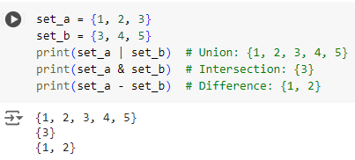
Sets
Operations
Removing Elements: Use remove() or discard()
Set Operations: Union, intersection, difference.

Slide 12


Dictionaries
A dictionary is an unordered collection of key-value pairs. Keys must be unique and immutable (e.g., strings, numbers).
Syntax
Defined using curly braces { } with key-value pairs separated by colons.
Operations
Accessing Values: Use keys.
Adding/Updating: Assign a value to a key.

Slide 13

Dictionaries
Operations
Removing Items: Use pop() to remove a key-value pair.
Key Characteristics of Dictionaries
Key-Value Pairs: Dictionaries store data as key-value pairs.
Immutable Keys: Dictionary keys must be immutable (e.g., numbers, strings, tuples).
Flexible Values: Dictionary values can be of any data type.
Unique Keys: Each key in a dictionary must be unique.
Unordered: Dictionaries are not ordered; elements are accessed using keys.

Slide 14
Comparing Lists, Tuples, Sets, Dictionaries
List | Tuple | Set | Dictionary
[] or list() | () or tuple() | {} or set() | {} or dict()
Ordered | Ordered | Unordered | Unordered
Changeable | Unchangeable | Unchangeable | Changeable
Indexed | Indexed | Unindexed | Key Value pair
Allows Duplicates | Allows Duplicates | No Duplicates | No Duplicates
Allows Slicing | Allows Slicing | No Slicing | No Slicing

Slide 15
Control Flow

Slide 16
Control Flow
Control flow statements are essential in programming as they enable the execution of specific blocks of code based on conditions. This allows for dynamic decision-making within a program. In Python, the primary control flow statements include if, elif, and else. We'll cover these concepts with detailed explanations and multiple examples to illustrate their use.

Slide 17

Control Flow
If Statements
The if statement is used to test a specific condition. If the condition evaluates to True, the code block under the if statement is executed.
Syntax

Slide 18
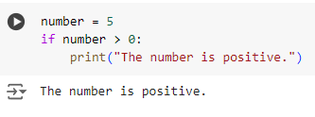
If Statements
Examples
Check Positive Number
This code checks if the number is greater than zero. Since 5 > 0 is true, it prints "The number is positive.

Slide 19
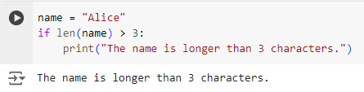
If Statements
Examples
Check String Length
The code checks if the length of the string name is greater than 3. Since "Alice" has 5 characters, the condition is true, and it prints "The name is longer than 3 characters."

Slide 20
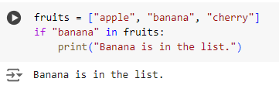
If Statements
Examples
Check Membership in List
The code checks if "banana" is an item in the fruits list. Since it is, the condition is true, and it prints "Banana is in the list."

Slide 21
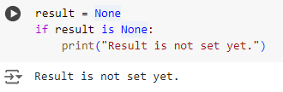
If Statements
Examples
Check if Variable is Not None
This code checks if result is None. Since it is, the condition is true, and it prints "Result is not set yet."

Slide 22
Control Flow
If-Else Statements
The if-else statement provides an alternative block of code that is executed if the condition is False.

Slide 23
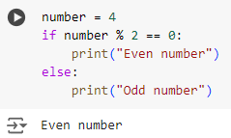
If-Else Statements
Examples
Check Even or Odd Number
This code checks if number is even by using the modulus operator %. Since 4 % 2 == 0 is true, it prints "Even number."

Slide 24
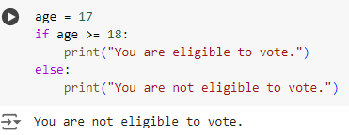
If-Else Statements
Examples
Age Verification
The code checks if age is 18 or older. Since age is 17, the condition is false, so it prints "You are not eligible to vote."

Slide 25
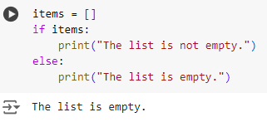
If-Else Statements
Examples
Check for Empty List
The code checks if items is a non-empty list. Since items is empty, the condition is false, and it prints "The list is empty."

Slide 26
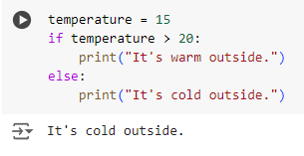
If-Else Statements
Examples
Temperature Check
This code checks if the temperature is greater than 20. Since 15 is not greater than 20, it prints "It's cold outside."

Slide 27
Control Flow
If-Elif-Else Statements
The if-elif-else statement allows checking multiple conditions sequentially. Only the block of the first True condition is executed. If none of the conditions are True, the else block is executed.

Slide 28
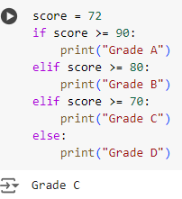
If-Elif-Else Statements
Examples
Grading System
This code assigns grades based on score. Since the score is 72, it matches the elif score >= 70: condition, so it prints "Grade C."

Slide 29
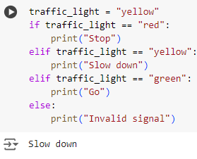
If-Elif-Else Statements
Examples
Traffic Light Signal
This code checks the color of traffic_light. Since it is "yellow," it matches the second condition and prints "Slow down."

Slide 30
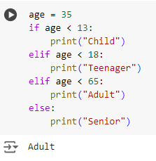
If-Elif-Else Statements
Examples
Classify Age Group
The code classifies age into different groups. Since 35 is less than 65 but more than 18, it matches the "Adult" category and prints "Adult."

Slide 31
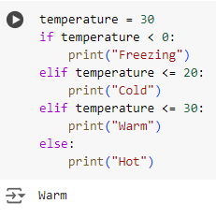
If-Elif-Else Statements
Examples
Check Temperature Range
The code checks which temperature range temperature falls into. Since it is 30, it matches the elif temperature <= 30: condition and prints "Warm."

Slide 32
Control Flow
Nested If Statements
If statements can be nested within other if statements to create complex conditions.

Slide 33
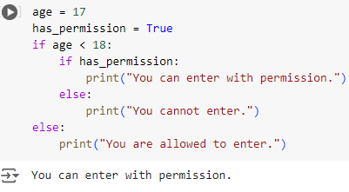
Nested If Statements
Examples
Permission Check with Age
This code checks if age is less than 18 and then checks if has_permission is True. Since both conditions are met, it prints "You can enter with permission."

Slide 34
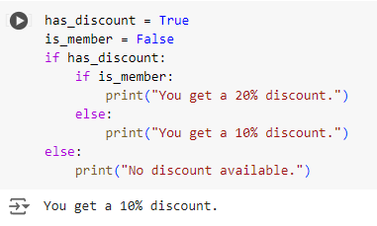
Nested If Statements
Examples
Nested Condition for Shopping
This code first checks if has_discount is True and then checks if is_member is also True. Since is_member is False, it prints "You get a 10% discount."

Slide 35
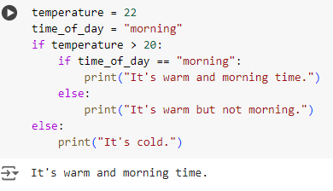
Nested If Statements
Examples
Nested Temperature and Time Check
This code checks if temperature is greater than 20 and then checks if it's morning. Since both conditions are true, it prints "It's warm and morning time."

Slide 36
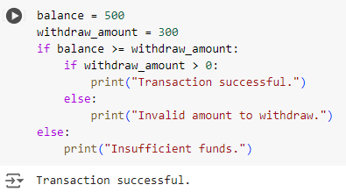
Nested If Statements
Examples
Bank Account Balance Check
This code checks if the balance is sufficient for the withdraw_amount and then checks if the amount is positive. Since both conditions are true, it prints "Transaction successful."

